Slide 1


KUEH SEOW TECK
8th December 2021

Slide 2

Outline
Executive Summary
Introduction
Methodology
Results
Conclusion
Appendix

Slide 3
Executive Summary
Summary of methodologies
Data Collection
Summary of all results
Exploratory data analysis results
Interactive analytics demo screenshots
Data wrangling
Exploratory data analysis (EDA):
Data visualization
SQL
Interactive visual analysis:
Folium
Plotly Dash
Predictive analysis using classification models
Predictive analysis results

Slide 4
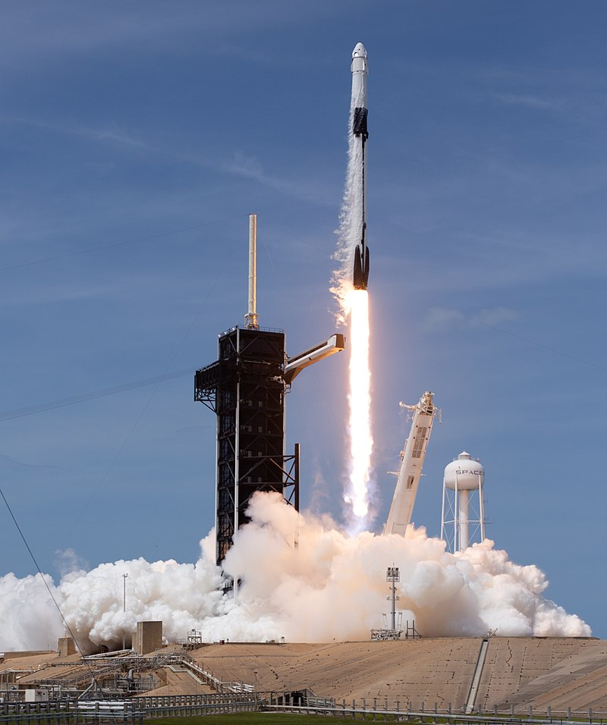
Introduction
Commercial space age is here and SpaceX is one of the most successful company in providing affordable space travel. This is due to its reusable first stage Falcon 9 rockets which if retrieve successfully can reduce cost of launch to mere 62 million dollars; other competitors cost upwards of 165 million dollars.
The purpose of this project is to predict if Falcon 9 first stage will land successfully. This can help us determine the cost of a launch which will be beneficial to have if we want to bid against SpaceX for a rocket launch.

Slide 5


Slide 6
Methodology
Executive Summary
Data collection methodology:
Describe how data was collected
Perform data wrangling
Describe how data was processed
Perform exploratory data analysis (EDA) using visualization and SQL
Perform interactive visual analytics using Folium and Plotly Dash
Perform predictive analysis using classification models
How to build, tune, evaluate classification models

Slide 7
Data Collection
Data is collected through to source:
SpaceX REST API
Falcon 9 and Falcon Heavy Launches Records Wikipedia page (web scrapping)
The following two slides shows the workflow of how the data collection process is performed.

Slide 8
Data Collection – SpaceX API
Get Response from API
Clean up data
Data wrangling
Decode the response as Json
Filter data to include only Falcon 9 launches
Filter the required columns
Extract data from the dataframe using custom functions
Convert the Json data into Pandas dataframe
Replace null value for PayloadMass by its average
Data collection through SpaceX REST API is performed in three stages:
Get request to the SpaceX API
Clean the data
Data wrangling
Github URL for reference.

Slide 9
Data Collection - Scraping
Getting request from URL
Extract data from BeautifulSoup Object
Convert dictionary to Pandas dataframe
Create a BeautifulSoup object from request
Find all the tables
Create dictionary from column names
Extract data from tables and append to dictinary
Web scraping SpaceX Wikipedia page is done in two stages:
Getting request from URL and save it as BeautifulSoup object
Extract data from BeautifulSoup object
Github URL for reference

Slide 10
Data Wrangling
Data wrangling is performed to determine the missing values are filled and data types for each columns are correct.
EDA is performed to identify patterns in the data and identify training labels
A new column named ‘Class’ is created to label successful outcomes as 1 and failed outcomes as 0.
Github URL for reference
Data Wrangling
Create Training labels from the outcomes
Load the SpaceX dataset
Identify the missing values
Identify the data types for each columns
Exploratory Data Analysis (EDA)
Calculate the number of launches on each site
Calculate the counts for each type of orbit
Determine the types and its value counts for all the mission outcome
Create a set called bad_outcome which contains the labels for failed mission outcome (‘False ASDS’,’False Ocean’,’False RTLS’,’None ASDS’ and None None'
Create a column named ‘Class’ by assigning successful launches as 1 and failed launches as 0 based on the bad_outcome set

Slide 11
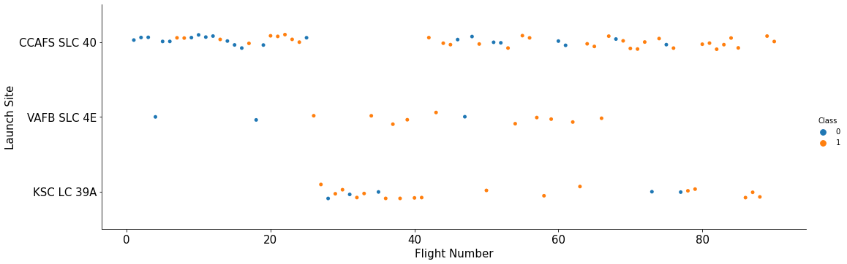
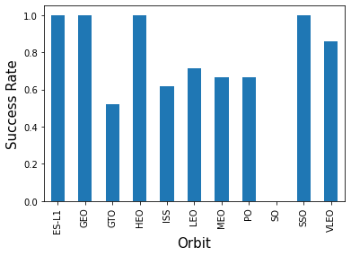
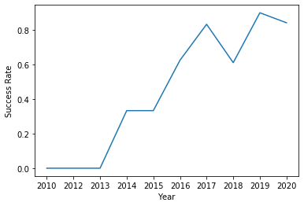
EDA with Data Visualization
Three types of graphs are used to perform EDA on the data
Scatter plots
Scatter plots are used to observe relationships between variables. In our case, we observe the relationship between flight number, payload mass, launch site, orbit and launch outcome.
Bar chart
Bar charts are used to compare things between different groups. In our case, we compare the success rate of the launch for different orbit types.
Line chart
Line charts are used to track changes over a period of time. In our case, we use line chart to visualize the success rate of the launches over multiple years
Github URL for reference

Slide 12
EDA with SQL
In order to understand the SpaceX Dataset, the dataset is loaded into a table in Db2 database.
SQL queries were executed to answer queries below:
Names of the unique lauch sites in the space mission
Display 5 records where the launch site begin with the string ‘CCA’
Find the total payload mass carried by booster launched by NASA (CRS)
Find the average payload mass carried by booster version F9 v1.1
Find the date for the first successful landing on a ground pad
List the names of the booster which landed successfully on drone ship and have payload mass of between 4000-6000kg
List the total number of successful and failed mission outcomes
List the names of booster_versions which have carried the maximum payload mass
List the failed landing_outcomes in drone ship, their booster versions, and launch site names for in year 2015
Rank the count of landing outcomes between the date 2010-06-04 and 2017-03-20, in descending order
Github URL for reference

Slide 13
Build an Interactive Map with Folium
Folium is used to visualize the launch data through an interactive map.
All the launch sites are plotted on a world map to explore the common characteristics of selecting these launch sites
Launch outcomes are color coded with 0 (Failure) as red and 1 (success) as green. These outcomes are plotted as individual points at the launch site and clustered together using MarkerCluster ( )
The distance between the launch sites its proximities is calculated to answer the questions below:
Are launch sites in close proximity to railways?
Are launch sites in close proximity to highways?
Are launch sites in close proximity to coastline?
Do launch sites keep certain distance away from cities?
Github URL for reference

Slide 14
Build a Dashboard with Plotly Dash
Plotly Dash is used to build interactive dashboard to visualize the launch data
Interactive pie chart is used to how success counts for all sites, as well as success rates for each sites.
Interactive scatter plot with a slider filter to filter the payload mass is used to visualize the relationship between success rate and payload mass.
Github URL for reference

Slide 15
Predictive Analysis (Classification)
Preparing dataset
Improving Model
Y dataset contains the ‘Class’ data
Calculate the best score for each models and compare which has be best score
Building Model
Below are the different types of machine learning algorithm model tested:
Test out different parameters to improve the model
X dataset contains the standardized feature data
Dataset is loaded into Pandas and NumPy
X ,Y data are split into training and test data sets
Logistic regression
Support vector machine
Decision tree classifier
K nearest neighbors
Find the best classification Model
Predictive analysis is broken into 4 phases:
Preparing dataset
Building Model
Improving Model
Identify best performing Model
Github URL for reference

Slide 16
Results
Exploratory data analysis results
Interactive analytics demo in screenshots
Predictive analysis results

Slide 17


Slide 18
Flight Number vs. Launch Site
There are more flights launched from CCAFS SLC 40 if compared to other launch sites
Almost all the initial 20 flights failed.
Flights 80 onwards have 100% successful launch.
Notes:
Show a scatter plot of Flight Number vs. Launch Site
Show the screenshot of the scatter plot with explanations

Slide 19
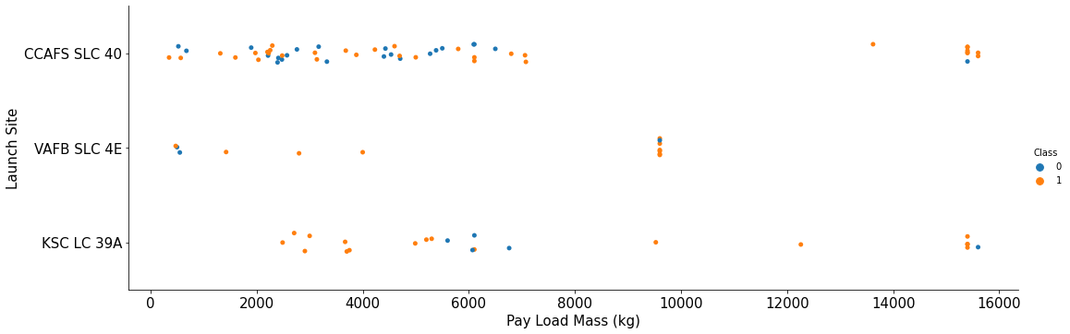
Payload vs. Launch Site
There are more launches with pay load mass of less than 8000kg

Slide 20
Success Rate vs. Orbit Type
Orbit ES-L1, GEO, HEO, SSO has 100% success rate while orbit SO has 0% success rate.

Slide 21
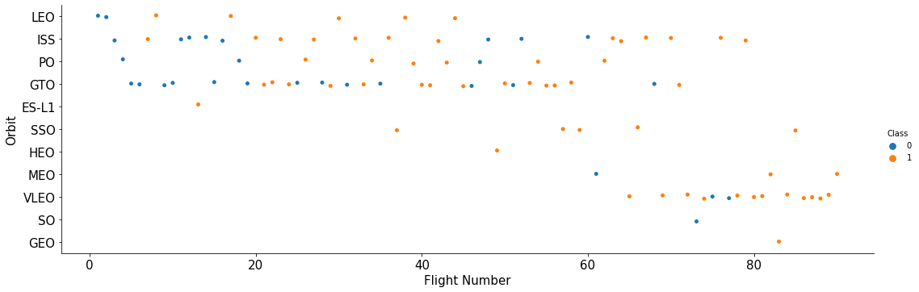
Flight Number vs. Orbit Type
Later flights (flights 60 and above) are more focused on VLEO orbit and has a relatively high success rate.

Slide 22
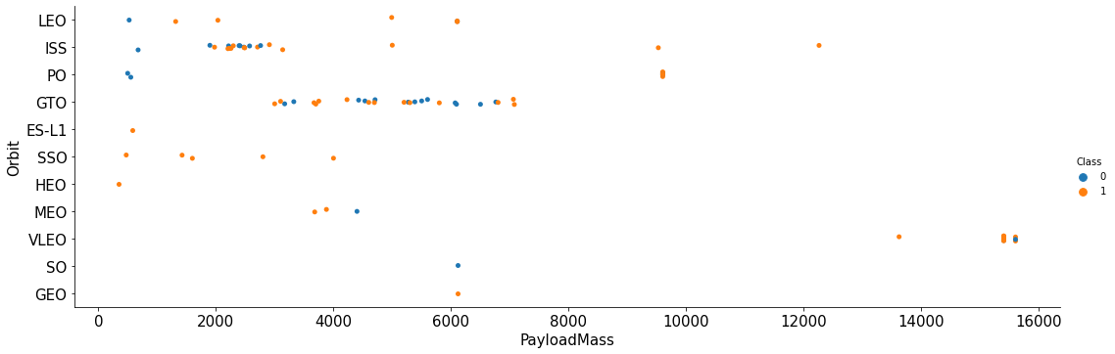
Payload vs. Orbit Type
Launches with payload mass <8000kg are mostly launched at ISS and GTO orbit
While the heavier payload mass launches (>14000kg) are launched towards the VLEO orbit.

Slide 23
Launch Success Yearly Trend
The success rate of the launches increase over the years since 2013 till year 2020, with a minor setback in year 2018

Slide 24
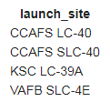
All Launch Site Names
Using DISTINCT to query unique values from launch_site column from table SPACEXTBL.
The query returns 4 unique launch sites CCAFS LC-40, CCAFS SLC-40, KSC LC-39A and VAFB SLC-4E

Slide 25
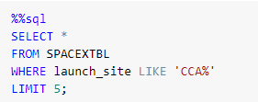
Launch Site Names Begin with 'CCA'
Using WHERE … LIKE to query columns where launch_site column has the keyword ‘CCA%’ (note: % is a wild card) and limit the query result to only 5 rows with LIMIT

Slide 26
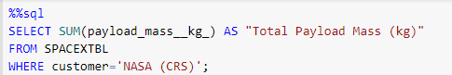
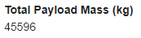
Total Payload Mass
Using SUM ( ) to find the total of column payload_mass_kg_ from the table SPACEXTBL
WHERE is used to include the customer NASA (CRS) in the summation.
The Total Payload Mass for NASA (CRS) is 45596 kg

Slide 27
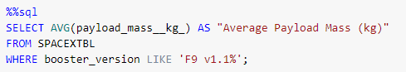
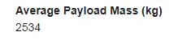
Average Payload Mass by F9 v1.1
AVG ( ) is used to get the average of the payload_mass_kg_ column from the table SPACEXTBL
WHERE is used to filter the data to include only booster_version F9 v1.1
% is used to include the variation of the F9 v1.1 booster.
The average payload mass for F9 v1.1 is 2534 kg

Slide 28
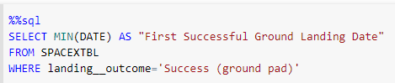

First Successful Ground Landing Date
MIN ( ) statement is used to find the minimum date in the DATE column from SPACEXTBL table
WHERE statement is used to filter the dataset to include only landing_outcome of ‘Success (ground pad)’.
The first successful ground landing date is 2015-12-22

Slide 29
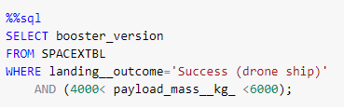
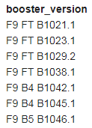
Successful Drone Ship Landing with Payload between 4000 and 6000
Select only the booster_version column
WHERE statement is used to filter out landing_outcome = ‘Success (drone ship)’
AND statement adds additional filter conditions to include only payload_mass_kg_ between 4000 and 6000kg

Slide 30
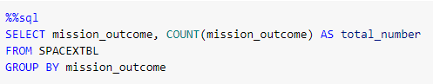
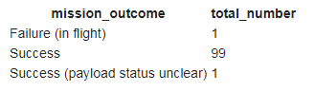
Total Number of Successful and Failure Mission Outcomes
Query the COUNT of mission_outcome from SPACEXTBL table, GROUP BY mission_outcome
There are 99 successful outcomes with 1 successful outcome with unclear payload status and 1 failure in flight.

Slide 31
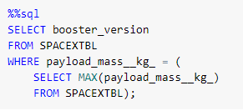
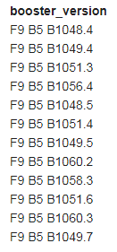
Boosters Carried Maximum Payload
First, perform a subquery to query the value for the maximum payload_mass__kg_ using MAX ( ) from SPACEXTBL table
Then, query the booster_version from SPACEXTBL table, WHERE the payload_mass__kg_ equals to the maximum value from the first query.

Slide 32
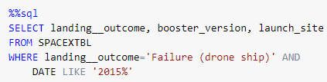
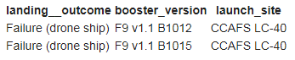
2015 Launch Records
SELECT three columns; landing_outcome, booster_version and launch_site from SPACEXTBL table
WHERE … AND statement is used to include two conditions; Failed landing on drone ship in the year 2015.

Slide 33
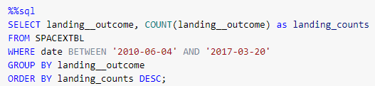
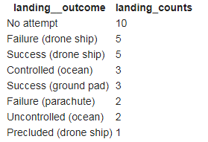
Rank Landing Outcomes Between 2010-06-04 and 2017-03-20
Query the COUNT of landing_outcome as landing_counts GROUP BY landing_outcome
Filter the data queried WHERE the data is BETWEEN ‘2010-06-04’ and ‘2017-03-20’.
Used ORDER BY… DESC to order the query outcome by landing_counts in descending order.
Most of the launch between those dates did not attempt landing.

Slide 34


Slide 35
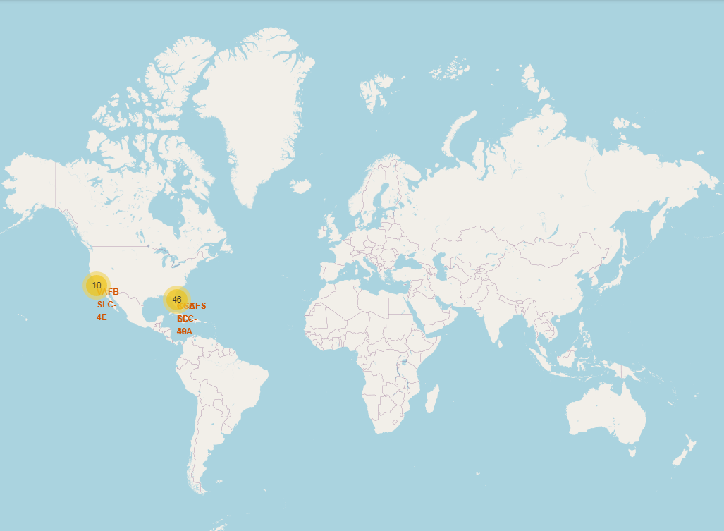
All launch sites marked on global map
Figure on the right shows all the launch sites for Falcon-9 plotted on a global map
All the launch sites are in the Southern part of United States of America and are all very close to the coasts.
All the launch sites are south towards the Equator

Slide 36
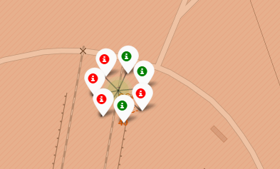
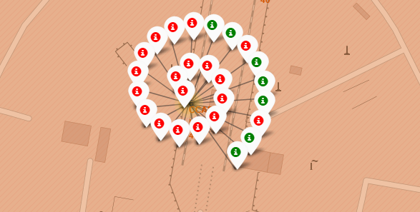
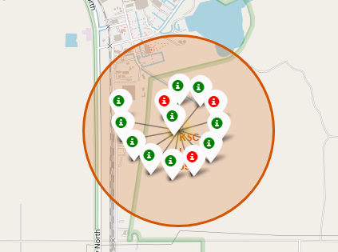
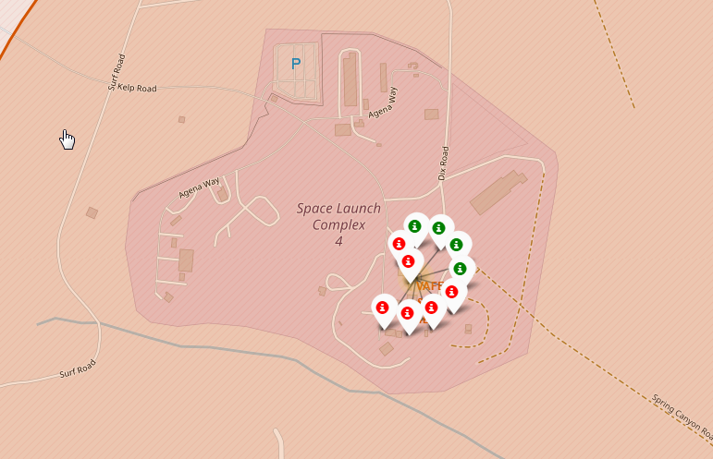
Color-labeled launch outcomes for all launch sites
The snapshots on the right shows color-labeled launch outcomes from all four Falcon-9 launch sites (Green marker: successful launch; Red marker: failed launch)
Kennedy Space Center Launch Complex 39 shows a higher success rate of rocket launch if compared with other launch sites.
Cape Canaveral Space Launch Complex 40
Cape Canaveral Launch Complex 40
Kennedy Space Center Launch Complex 39
Vandenberg Space Launch Complex 4

Slide 37
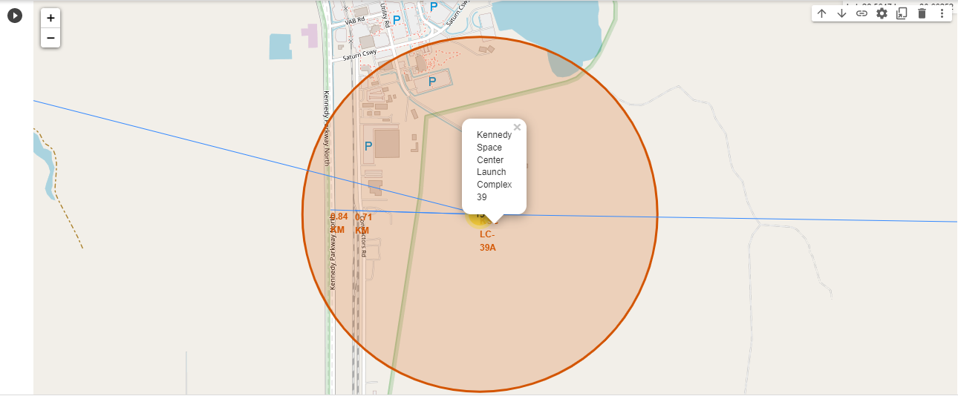
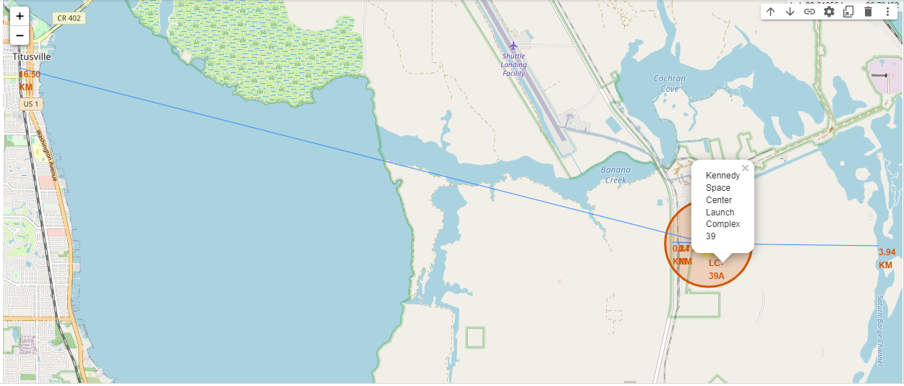
Distance between Kennedy Space Center Launch Complex 39 and its Proximities
The two figure on the right shows the distance between Kennedy Space Center Launch Complex 39 and its proximities
Table below shows a summary of the distance
Proximities | Distance (km)
Railway | 0.71
Highway | 0.84
Coastline | 3.94
Nearest town | 16.50
Launch sites are in close proximity with railways, highways and coastlines but very far away from cities

Slide 38


Slide 39
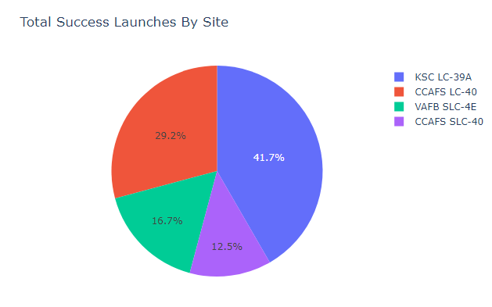
Launch success count for all sites
The piechart shows the success count for all launch sites.
KSC LC-39A launch site has the most number of successful launches if compared with other sites
Notes:
Replace <Dashboard screenshot 1> title with an appropriate title
Show the screenshot of launch success count for all sites, in a piechart
Explain the important elements and findings on the screenshot

Slide 40
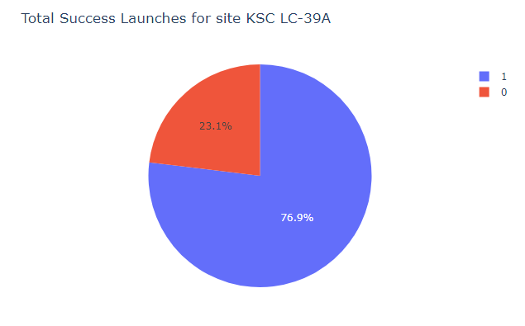
Piechart for the launch site with highest launch success ratio
KSC LC-39A has a 76.9% success rate and 23.1% failure rate.
Notes:
Replace <Dashboard screenshot 2> title with an appropriate title
Show the screenshot of the piechart for the launch site with highest launch success ratio
Explain the important elements and findings on the screenshot

Slide 41
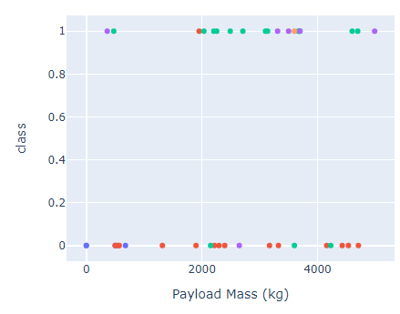
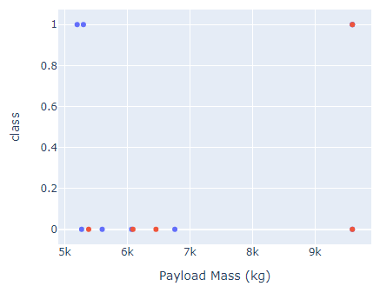
Payload vs. Launch Outcome scatter plot for all sites
The figures on the left shows the payload vs. launch outcome scatter plot for all sites for low weighted payloads (<5000kg) and high weighted payloads (>5000kg)
Low weighted payloads has a higher success rate compared to heavy weighted payloads
Low weighted payload (0-5000kg)
High weighted payload (>5000kg)
Notes:
Replace <Dashboard screenshot 3> title with an appropriate title
Show screenshots of Payload vs. Launch Outcome scatter plot for all sites, with different payload selected in the range slider
Explain the important elements and findings on the screenshot, such as which payload range or booster version have the largest success rate, etc.

Slide 42


Slide 43
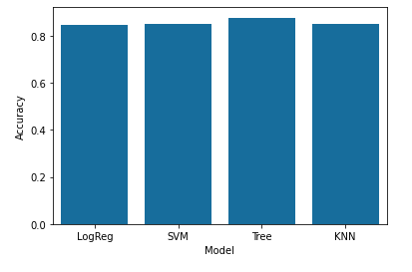
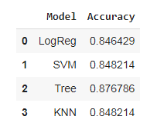
Classification Accuracy
Bar chart on the right shows the accuracy for all four classification models; logarithmic regression, support vector machine, Decision tree, and K Nearest Neighbor model.
Decision tree classifier model has the highest accuracy among the four models tested for this dataset.

Slide 44
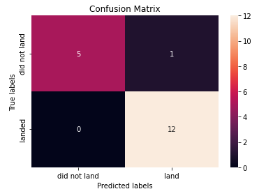
Confusion Matrix
The confusion matrix for the decision tree classifier shows that the model almost perfectly predicted the outcomes with just one false positive.

Slide 45
Conclusions
From EDA through visualization:
Success rates increases over the years as more launches are completed
More launches has pay load mass of less than 8000kg
Orbit ES-L1, GEO, HEO, SSO has 100% success rate
From EDA through SQL:
Total payload mass for NASA (CRS) is 45596kg
Average payload mass for F9 v1.1 rockets is 2534kg
Out of all the launches in the SQL table, there are 100 successful outcome with 1 failure.

Slide 46
Conclusions
From Folium map:
Kennedy Space Center Launch Complex 39 has the highest launch success rate
The launch center are near to railway, highway and coastline but far away from towns
From Plotly Dash interactive dashboard:
Kennedy Space Center Launch Complex 39 has the highest launch success rate
Launches with low weighted payloads (<5000kg) has a higher success rate.
From predictive analysis (Classification):
Decision tree model has the highest accuracy score (0.8767) among the models tested for this dataset.

Slide 47
Appendix
None

Slide 48


